Slide 1
Essential Steps in Data Preprocessing and Cleaning
By
Oroos Arshi
Research Scholar, UPES Dehradun. India
Mentor at AIEYS

Slide 2
What is data preprocessing and Cleaning
Data Preprocessing refers to the steps taken to prepare raw data for analysis or modeling.
Data Cleaning involves fixing or removing errors, inconsistencies, and missing data.
Why it Matters:
Enhances the quality of input data.
Boosts model performance and reliability.

Slide 3
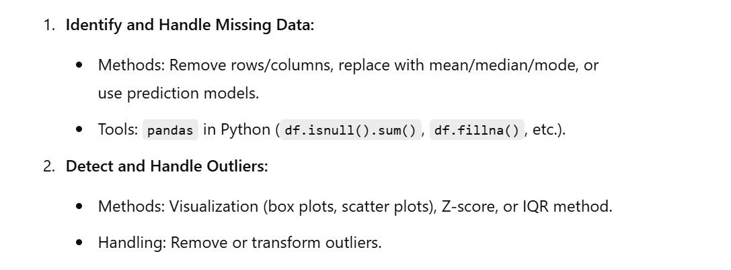
Data Cleaning
Key Steps in Data Cleaning

Slide 4
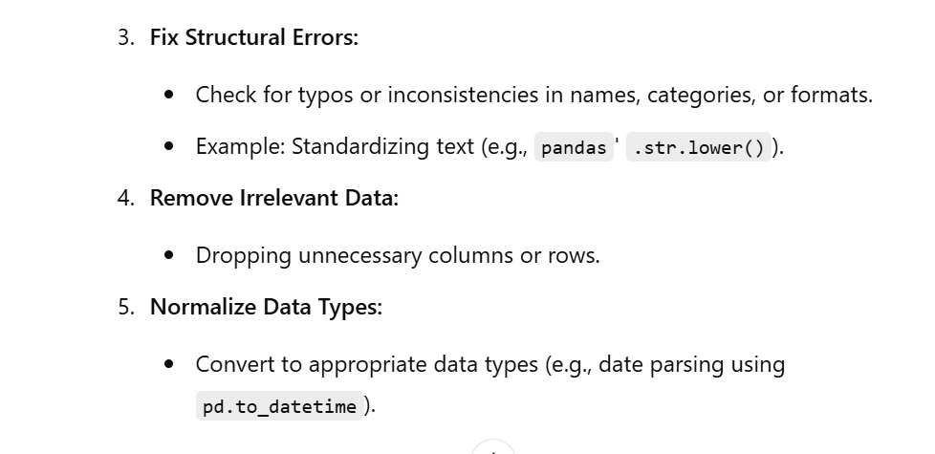

Slide 5
Overview of Data preprocessing steps
Key Steps in Data Preprocessing
1. Data Cleaning
Fix missing values, outliers, and structural errors.
2. Data Transformation
Normalize, scale, or encode data as needed.
3. Feature Engineering
Create, combine, or select features.
4. Data Splitting
Divide data into training, validation, and testing sets.

Slide 6
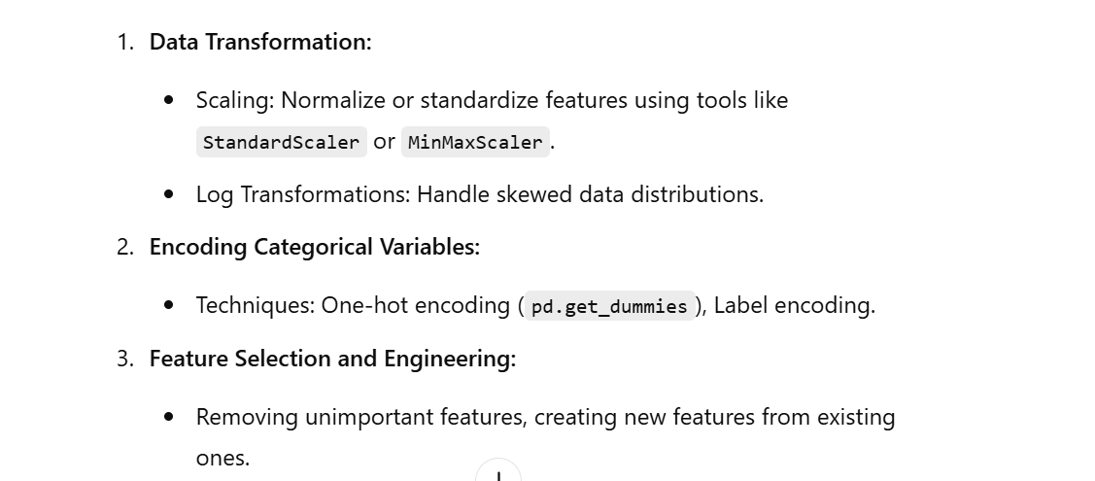
Key Steps in Data Preprocessing

Slide 7
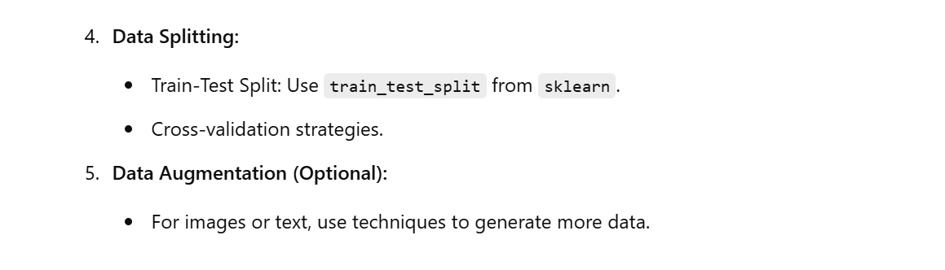

Slide 8
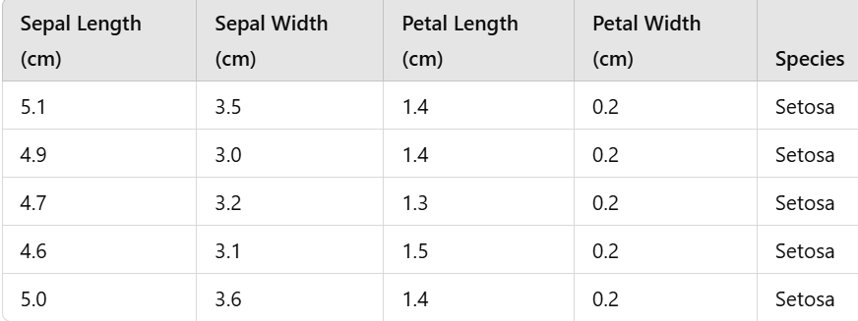
Practical Example
Preprocessing Iris dataset
What is the Iris Dataset?
The Iris dataset is a classic dataset in machine learning.
Target Variable: Species: Setosa, Versicolor, Virginica
Goal: Predict species based on flower measurements

Slide 9
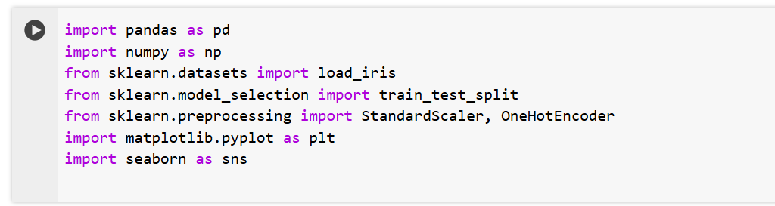
Import the Libraries

Slide 10
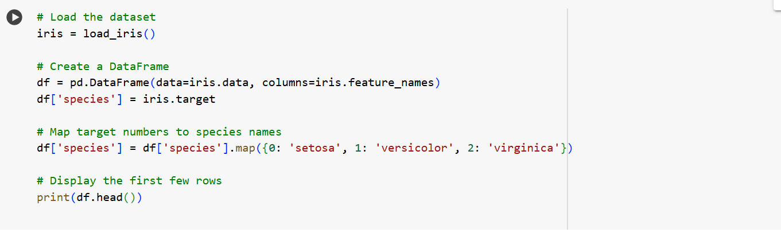
Load the Dataset

Slide 11
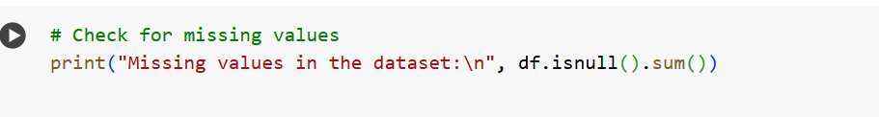
3. Data cleaning
Check for Missing Values
Since this dataset is clean, we will artificially introduce missing values for practice

Slide 12
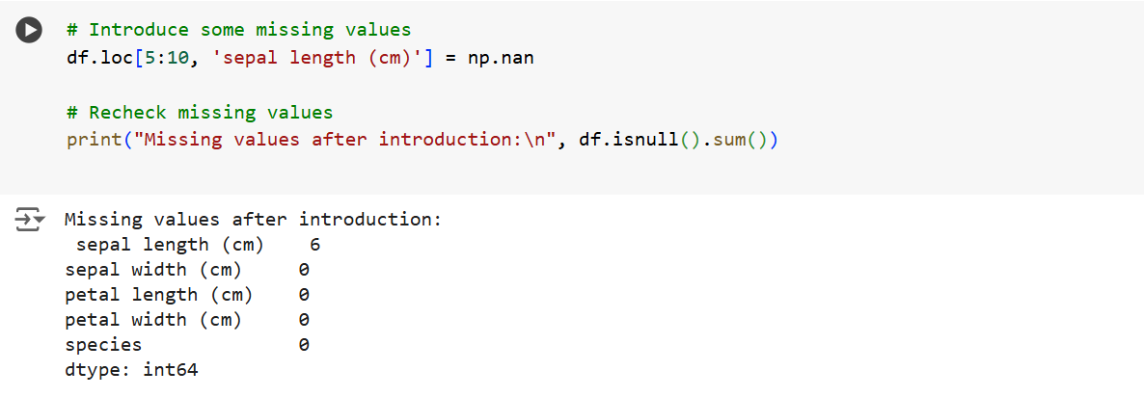

Slide 13
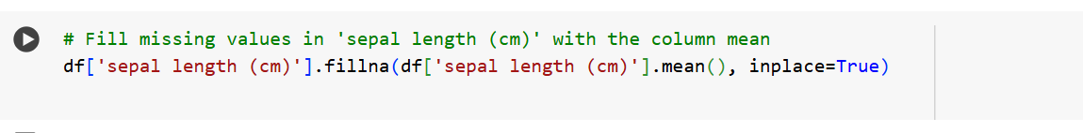
Handle Missing Values
Handle Missing Values

Slide 14
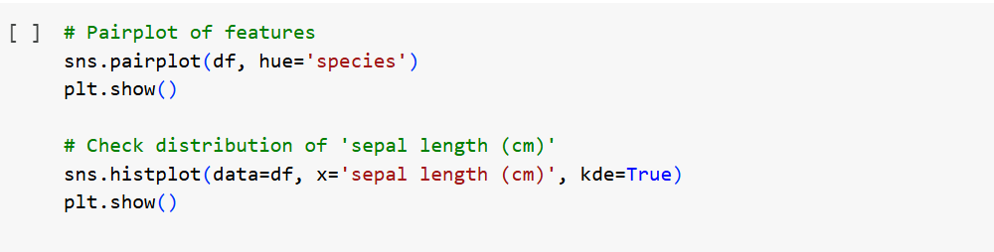
4. Exploratory Data Analysis (EDA)
Visualize the data
A process of summarizing, visualizing, and understanding data patterns and relationships.

Slide 15
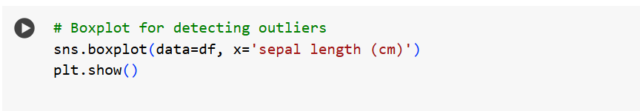
Detect outliers
Data points are significantly different from most other points in a dataset.

Slide 16
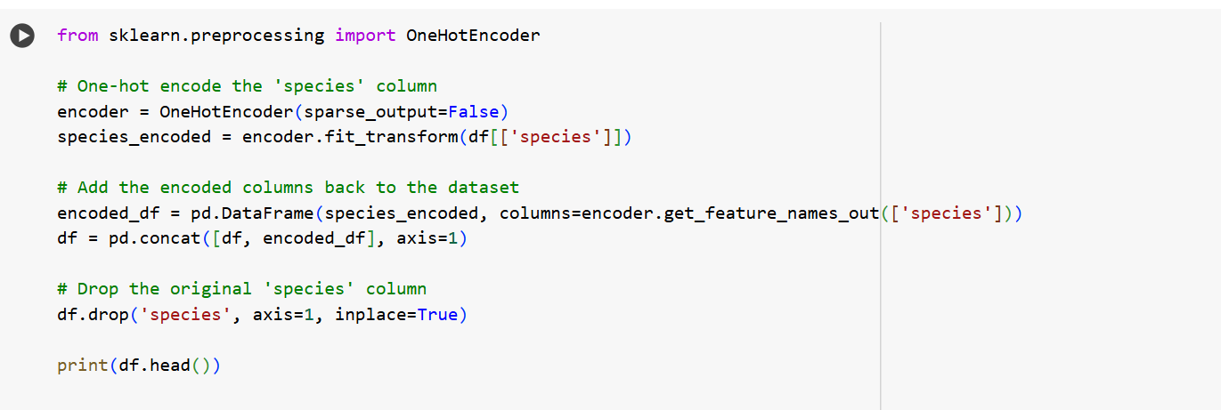
5. Data Transformation

Slide 17
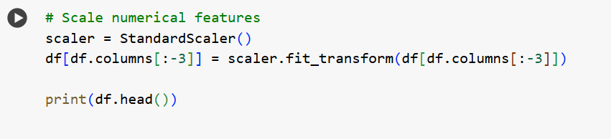
Scale the Features
Standardizing or normalizing numeric features to bring them to a similar scale.

Slide 18
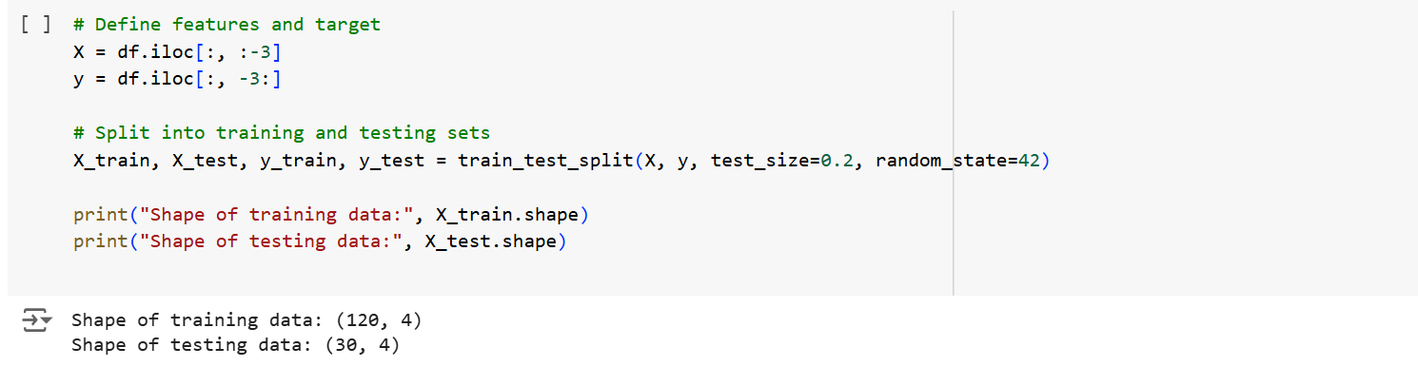
6. Splitting the dataset
A subset of data used to train a machine learning model.
Divide the data into training and testing sets using train_test_split.
Use 80% for training and 20% for testing to evaluate model performance.

Slide 19
Summary
This code demonstrates:
Loading and exploring the Iris dataset.
Introducing and handling missing values.
Visualizing data distributions and detecting outliers.
Encoding categorical variables.
Scaling numerical features.
Splitting the data for training and testing.

